Slide 1
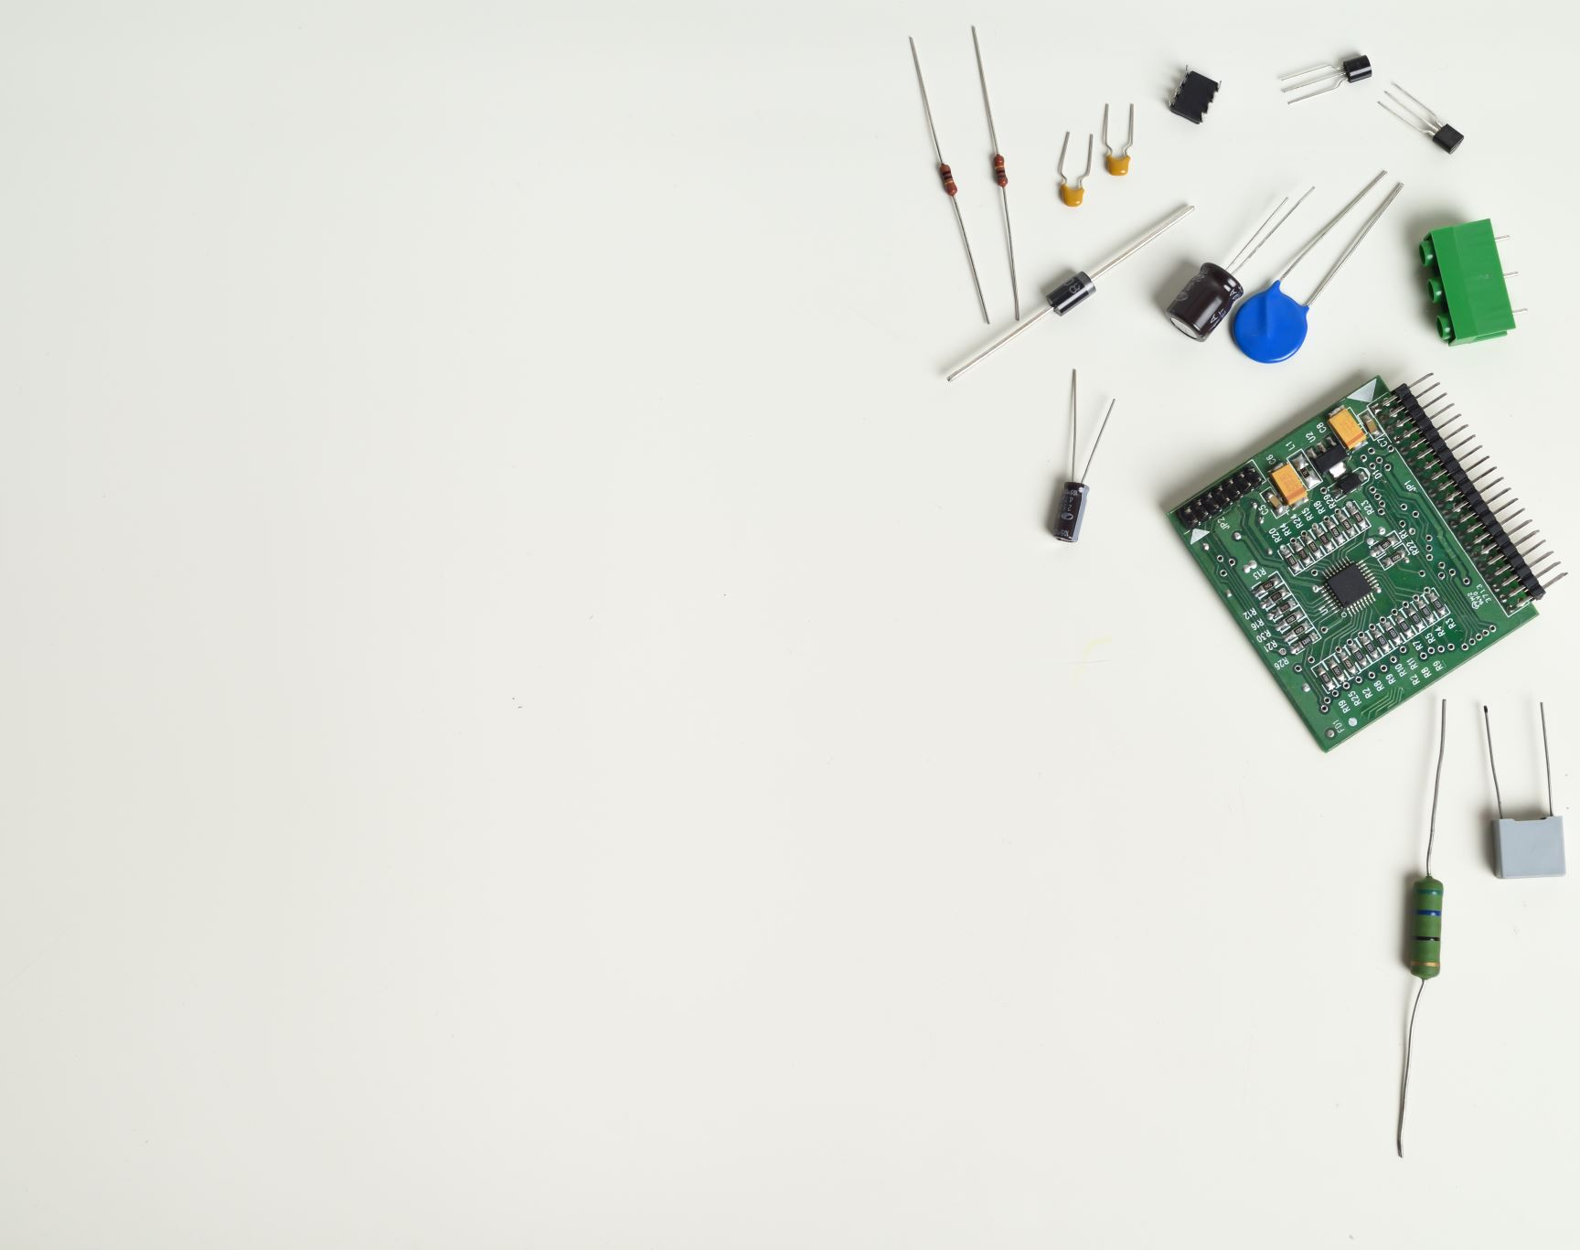
Communication Protocols in IoT
Overview

Slide 2
Communication we come across in IoT
03
Thing-to-Internet
For any two devices to communicate with each other we need a connectivity
The connectivity to the network could be wired or wireless
There three types of Networking seen in IoT
02
Thing-to-Proxy
01
Thing-to-Things

Slide 3
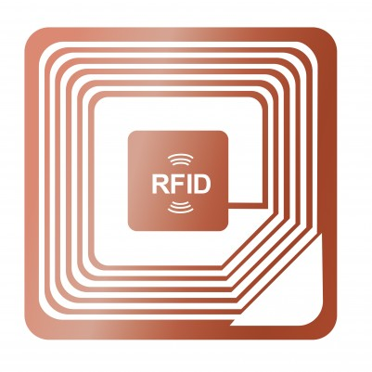
Thing-to-Things
In Thing-to-Things Networking, one thing communicates with other thing/things by sending messages, commands or data
Example: Thing-to-Things communication is seen in RFID Technology

Slide 4
RFID Tag
A basic RFID system comprises two parts: the Tag, and the Reader.
1
Tag
The RFID tag has an embedded transmitter and receiver. The actual RFID component contained in a tag has two parts:
An integrated circuit for storing and processing information, and an antenna to receive and transmit a signal
The RFID tag has non-volatile memory storage, and can included either fixed or programmable logic for processing transmission and sensor data

Slide 5
RFID Tag
Tags can be passive, active, or battery-assistive passive
Tag
A Passive Tag is the cheapest option, and features no battery. The tag uses radio energy transmitted by the reader
An Active Tag features an onboard battery, periodically transmitting its credentials
A Battery-Assistive Passive Tag also features a small onboard battery, but is only activated when in the presence of an RFID reader
Furthermore, a tag may be either read-only, or read/write. A read-only tag has a factory assigned serial number used for identification in a database, while a read/write tag can have specific custom data written to the tag by the user
1

Slide 6
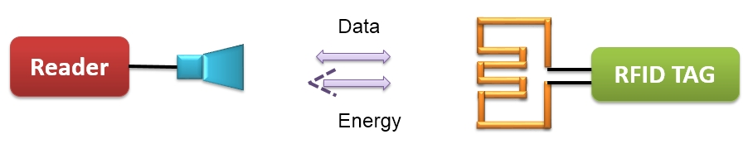
RFID Working
In most of the RFID system, tags are attached to all items that are to be tracked. These tags are made from a tiny tag-chip that is connected to an antenna.

Slide 7
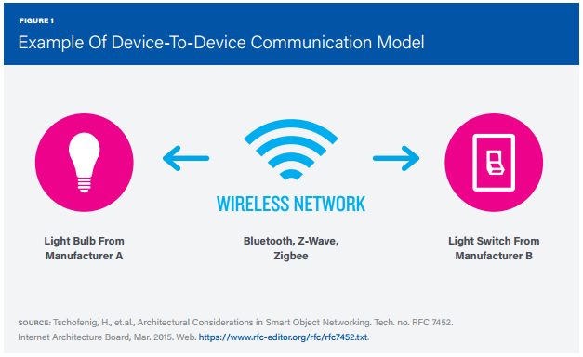
Thing-to-Proxy
In this case, switch is sending a command to bulb
In Thing-to-Proxy Networking, one thing communicates with other thing/things by sending messages, commands or data via Proxy/Hub

Slide 8
Thing-to-Proxy
Via Hub
Thing-to-Proxy communication can happen with Bluetooth, WIFI, ZigBee etc. via Hub

Slide 9
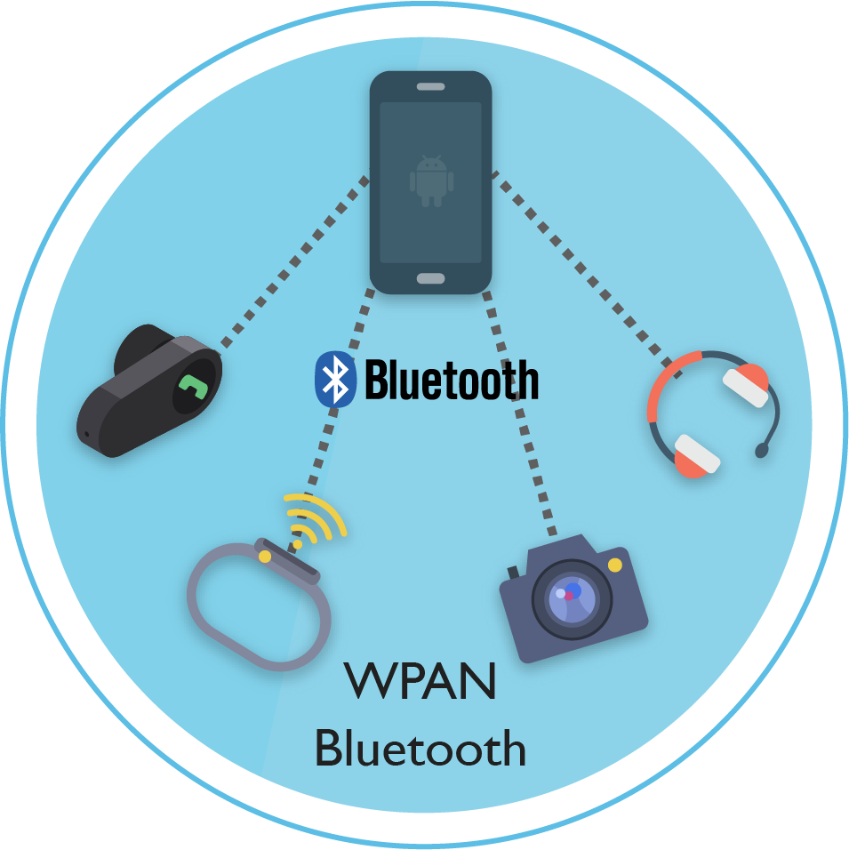
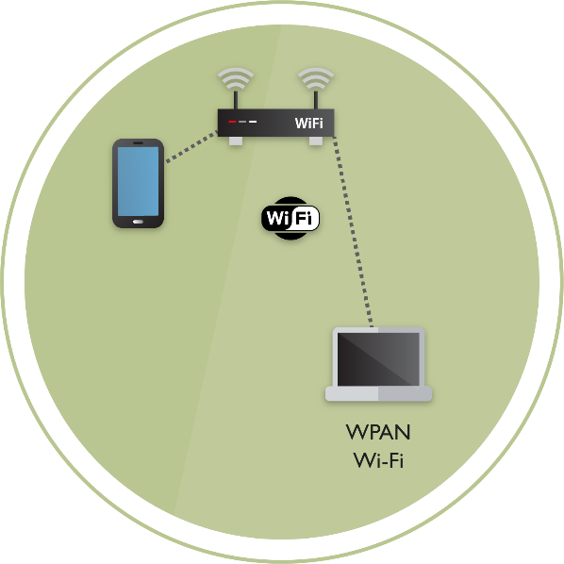
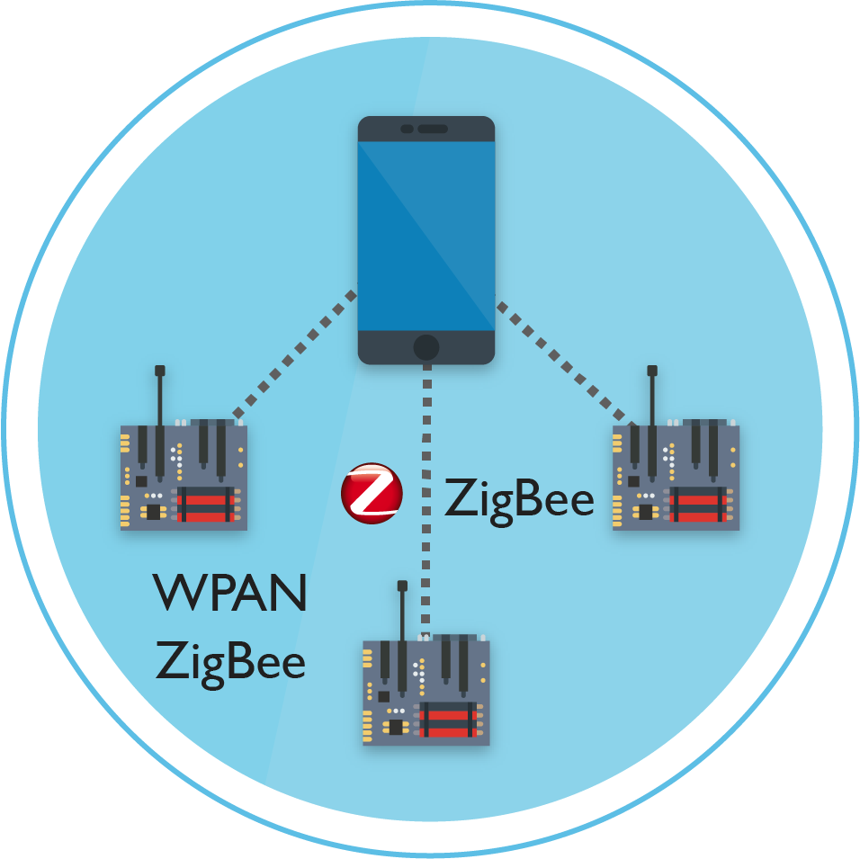
Thing-to-Proxy Networking : Example
Below are few examples for Thing-to-Things Networking:
Bluetooth
WIFI
ZigBee

Slide 10
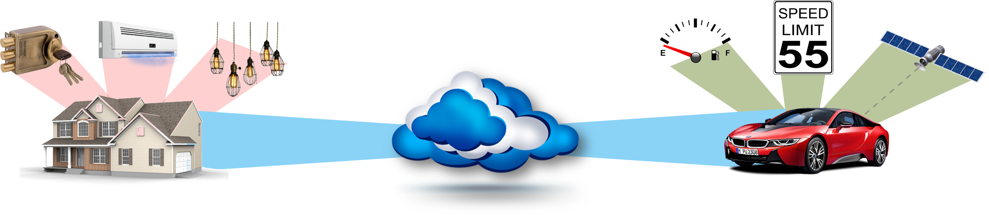
Things-to-Internet
Things-to-Internet connection can be a direct connection or via proxy

Slide 11
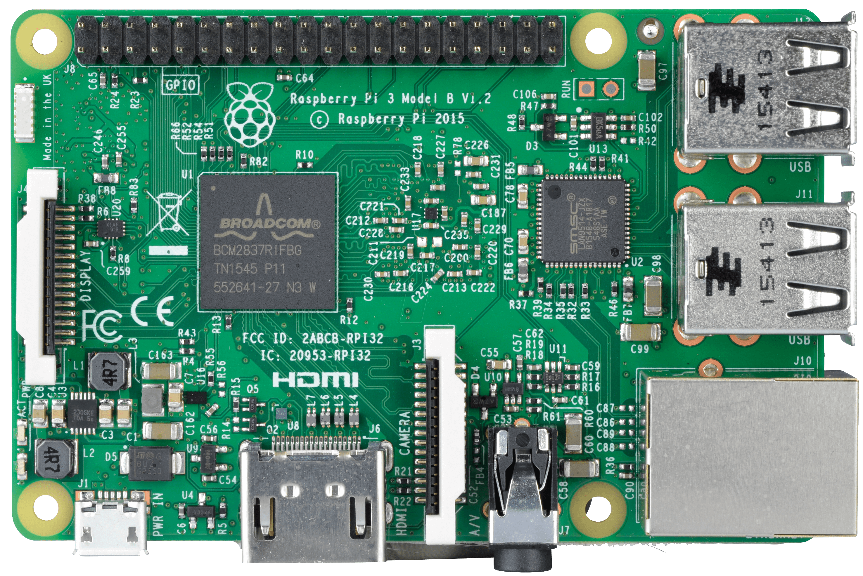
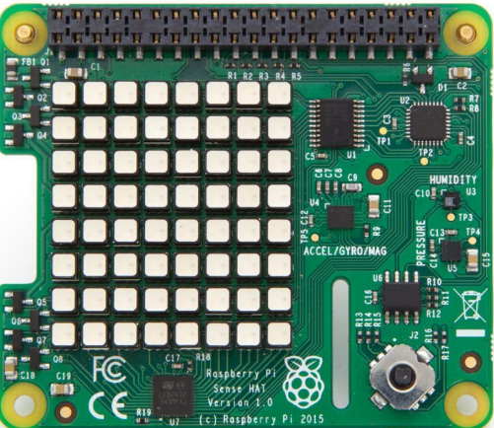
Things-to-Internet
Things-to-Internet connection can be a direct connection or via proxy
Direct connection to internet with LAN or WIFI
Connection to internet via Proxy (i.e. RaspberryPi)

Slide 12

IoT Communication Requirements
Therefore, it is crucial to choose the best IoT connectivity option for your specific needs
Battery life
High-bandwidth
Security
Time
Let us discuss the major ways in which IoT devices connect to Internet

Slide 13
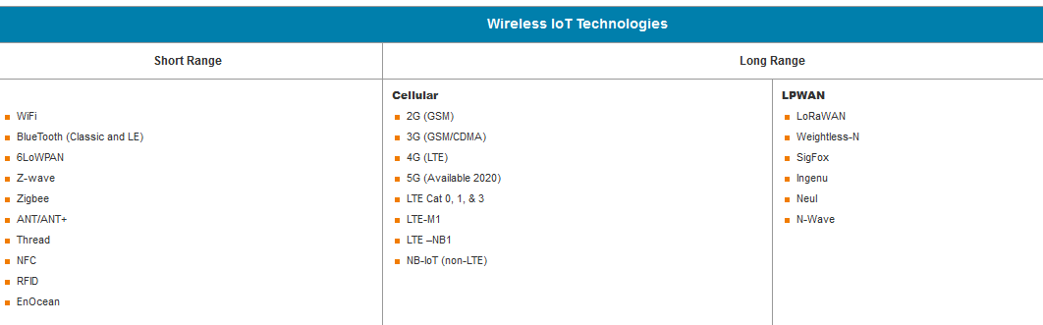
IoT Wireless Connectivity
IoT devices mostly connect to internet Wirelessly
Based on the range of coverage , Wireless IoT Technologies are classified as:

Slide 14

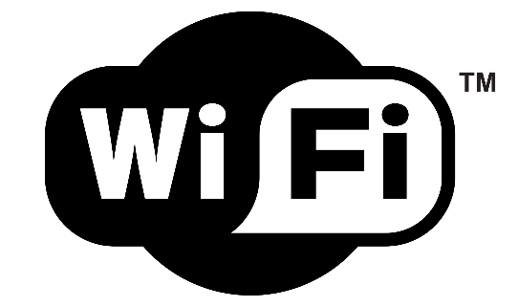


Wireless IoT Networking: Short Range
In short range, we will discuss the below networks, which are widely in use:
Bluetooth
WIFI
ZigBee
6LoWPAN

Slide 15

BLE Use Case: iBeacon (Protocol Developed by Apple)
iBeacon is based on Bluetooth Low Energy proximity sensing by transmitting a universally unique identifier picked up by a compatible app or Operating System
iBeacon can be used to determine the device's physical location, track customers, or trigger a location-based action on the device such as a check-in on social media or a push notification

Slide 16

BLE Use Case: iBeacon (Protocol Developed by Apple)
A beacon campaign called the “Pink Light Campaign” is being trailed on subways in the city of Busan, South Korea
To combat the risk of miscarriage for pregnant women by offering priority seating on public transport for them via beacons
Use Case: Problem
01
02
Use Case: Solution
South Korea is eagerly encouraging its residents to have larger families given that the country’s birth-rate is one of the lowest birth-rates in the world

Slide 17



BLE Use Case: iBeacon (Protocol Developed by Apple)
4
Once the system detects that the woman is seated, the light switches off
First beacon is attached to bag or any accessory of pregnant women
1
3
5
2
The system aims to make public transportation easier for pregnant women
The blinking of the pink sensor lets people know that a pregnant lady is aboard and will need a vacant seat. Especially alerts other passengers who might be sitting in the courtesy seat
The second is the light sign that is installed on trains. As soon as a pregnant woman gets on board, the beacon she is carrying signals the light to flash

Slide 18
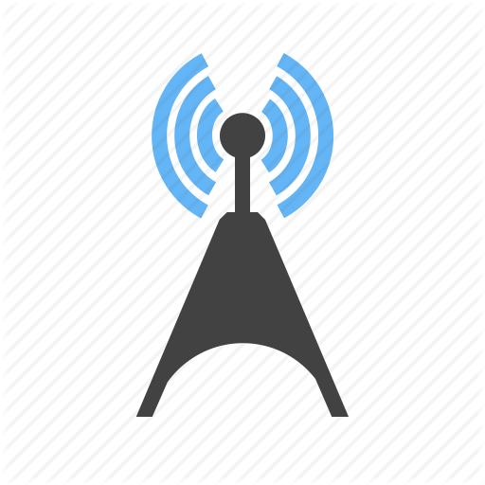
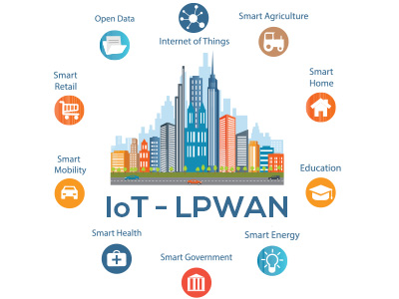
Wireless IoT Networking: Long Range
In long range wireless IoT Networking, let us discuss:
Cellular
LPWAN
Cellular
LPWAN

Slide 19
Connecting to Internet
Ethernet (built-in), plug it in anywhere
Wi-Fi (built_in), configured once per location
3G (dongle), configured once, easy to use

Slide 20
Connection Protocols
IP Enabled Connection
LAN
Wifi
3G / 4G
Wired Connection (RS232 / RS485)
Wireless Connection
Bluetooth
Zigbee
LoRaWan

Slide 21
Protocols Used
HTTP Requests
REST (REpresentational State Transfer)
MQTT (Message Queue Telemetry Transport)
DDS
AMQP
JMS
CoAP
Many more

Slide 22
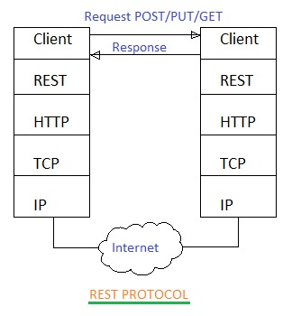
REST

Slide 23
Application layer IoT Network Technologies
HTTP and HTTPS are ubiquitous across internet applications, which is true also within IoT, with RESTful HTTP and HTTPS interfaces widely deployed
Request
[{“city”: “Bangalore”, “price”: “rupees”}]
/flight/availability
Get
Client
Server
Post
Response
[{“low”: “2500”, “high”: “5500”}]

Slide 24
MQTT
MQTT is a lightweight publish and subscribe system, where you can publish and receive messages as a client, it runs on top of TCP
Publish
Subscribe
It is a simple communication between multiple devices and simple messaging protocol for
Constrained Devices
Low Bandwidth
These properties make MQTT perfect solution for Internet of Things applications

Slide 25
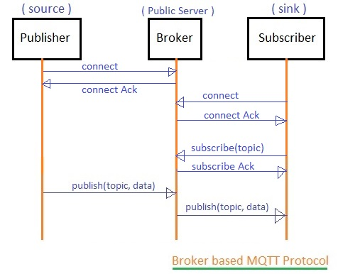
MQTT

Slide 26
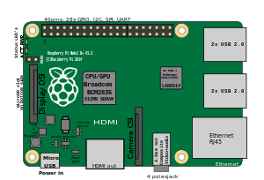


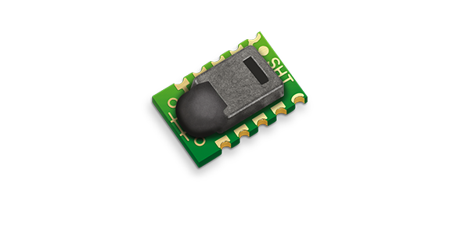
What does MQTT allow?
Here's a quick overview of what MQTT allows you to do:
MQTT
MQTT
Send a command to control an output
or
A programming language
RaspberryPi
Light
MQTT
MQTT
Read data from a sensor and publish it
Sensor

Slide 27
Concepts of MQTT
In MQTT, there are few basic concepts which you need to understand:
Publish / Subscribe
Messages
Topics
Broker

Slide 28
MQTT: Broker
The broker is primarily responsible for:
Receiving all messages
Filtering the messages
Deciding who is interested in topic and then publishing the message to all subscribed clients
Publish
Publish
Device 1
Broker
Device 2
Subscribe

Slide 29
Thank you

